Slide 1






PocketPaw Co: Finances II
YOUR PET IN YOUR POCKET

Slide 2
Our team
David Pérez
Federico
Falcone
Guillem
Escriba
Oriol Soler
CEO
CFO
CEO
GENERAL MANAGER
Data Science Engineer
Computer Engineer
Data Science Engineer
Audiovisual Engineer

Slide 3
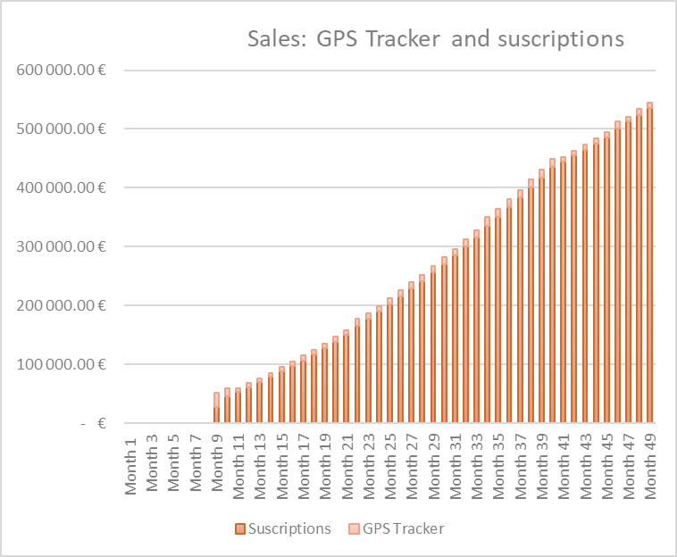
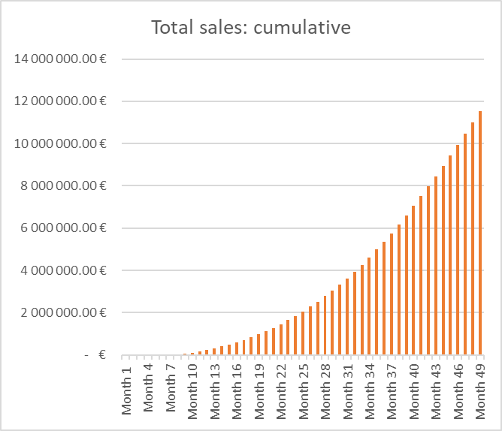
REVENUES - SALES

Slide 4
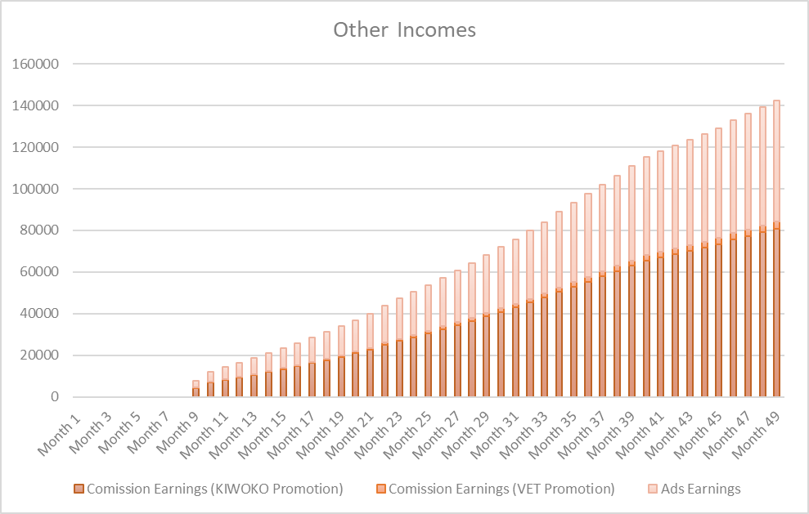
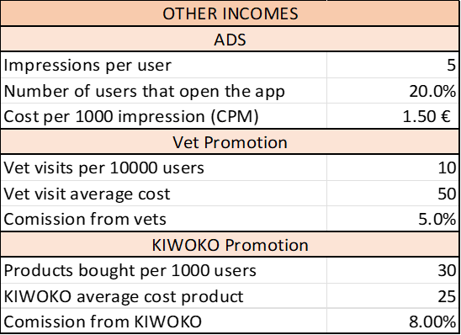
REVENUES - OTHERS

Slide 5
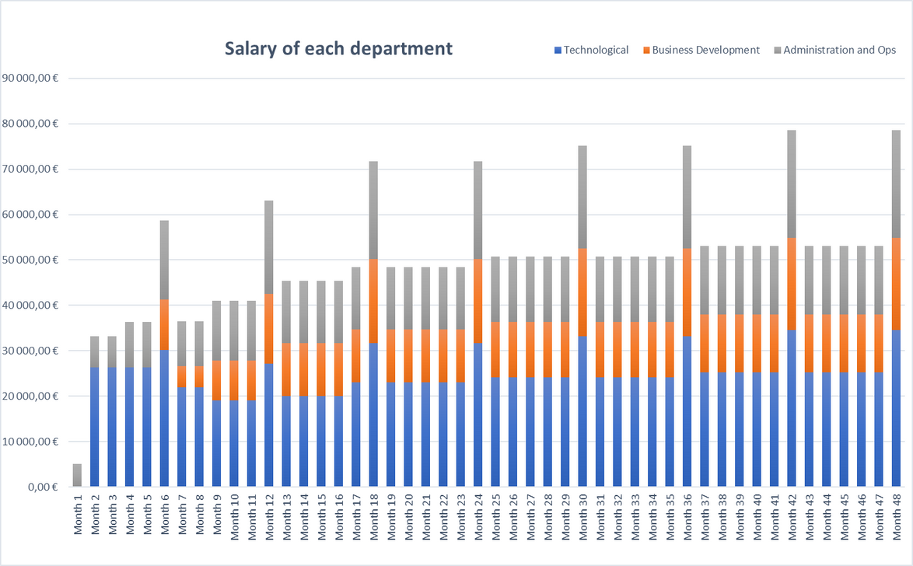
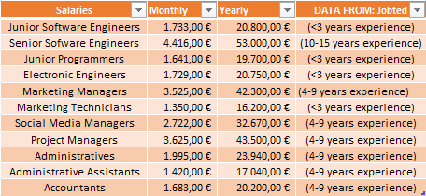
EXPENSES - SALARIES (23%)
*Real data from today's wages in Spain
*Tax of salary increasement: 5%
Modelling headcounts by company stages (studied in spreadsheets)

Slide 6
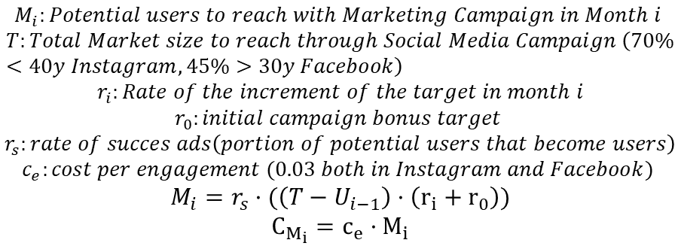
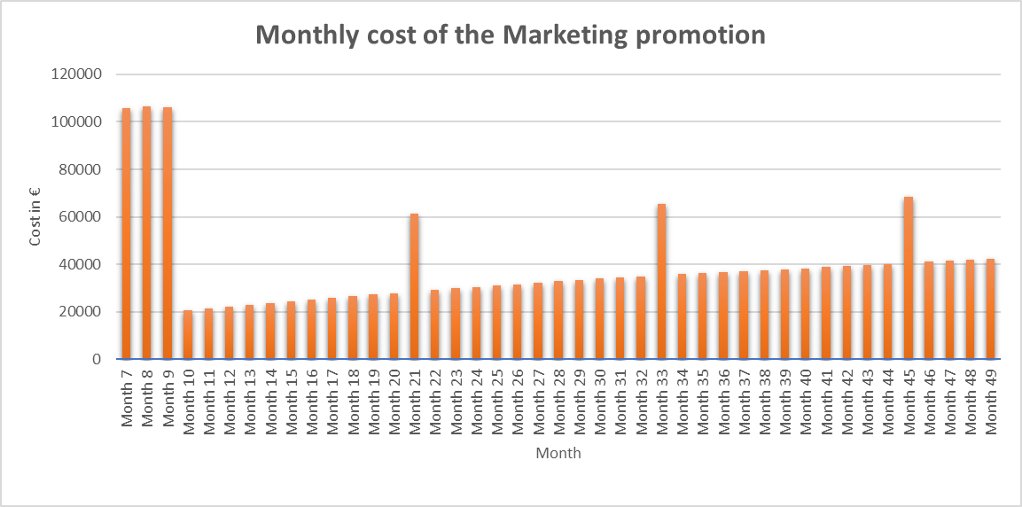
EXPENSES - MARKETING (16%)
Initial Campaign
1st Anniversary update campaign
2nd Anniversary update campaign
3rd Anniversary update campaign

Slide 7
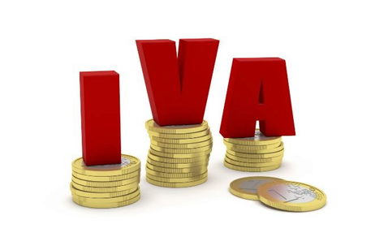
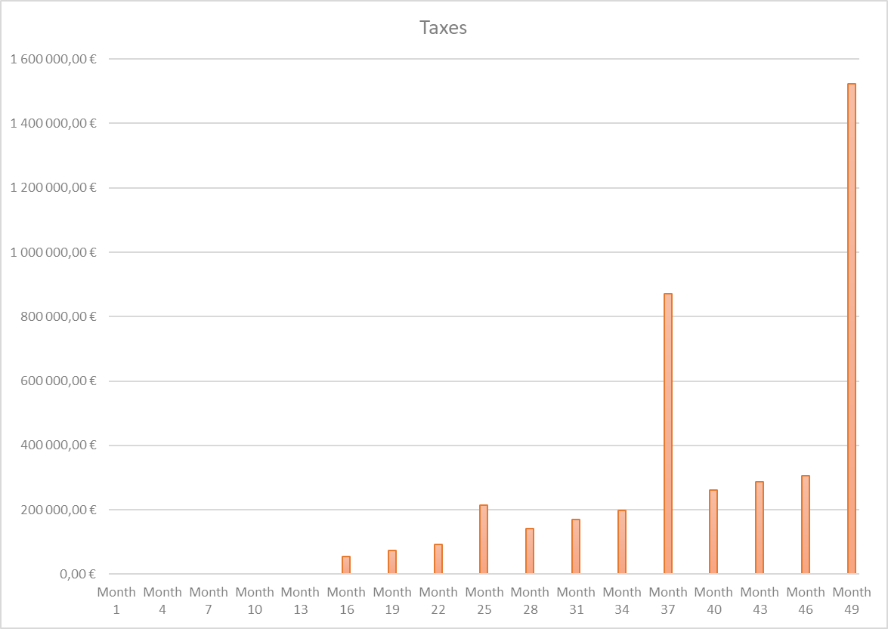

TAXES (38%)
(not considered in Income Statement)
Generated every month, but paid at the end of the quarter
No Benefits
Generated every month, but paid at the end of the year.

Slide 8
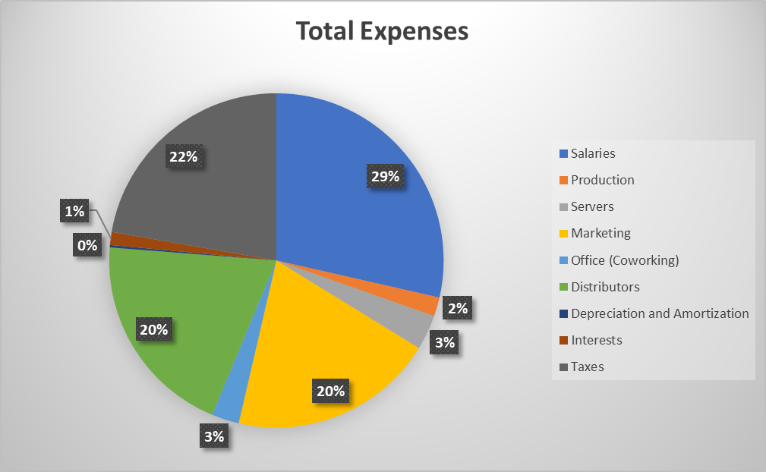
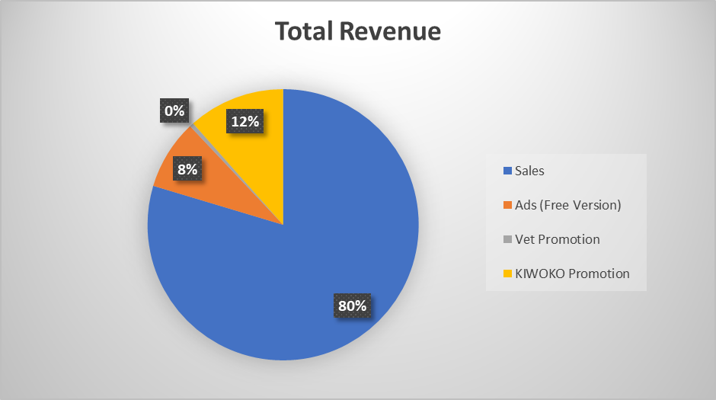
P&L

Slide 9
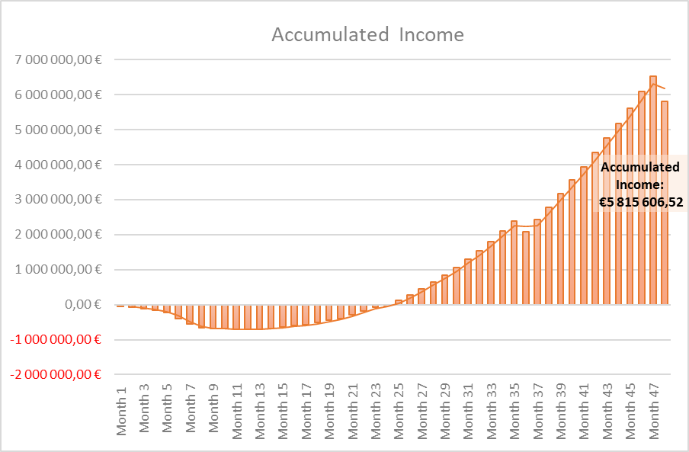
P&L BreakDown
Since this is the income statement total balance, 21% taxes from IVA are not taken into account here, so the actual accumulated cashflow slighly decreases.
Same applies with all the case scenarios.
In the spreadsheets there are also considered different situations incomes, such as the total balance with no loans.

Slide 10
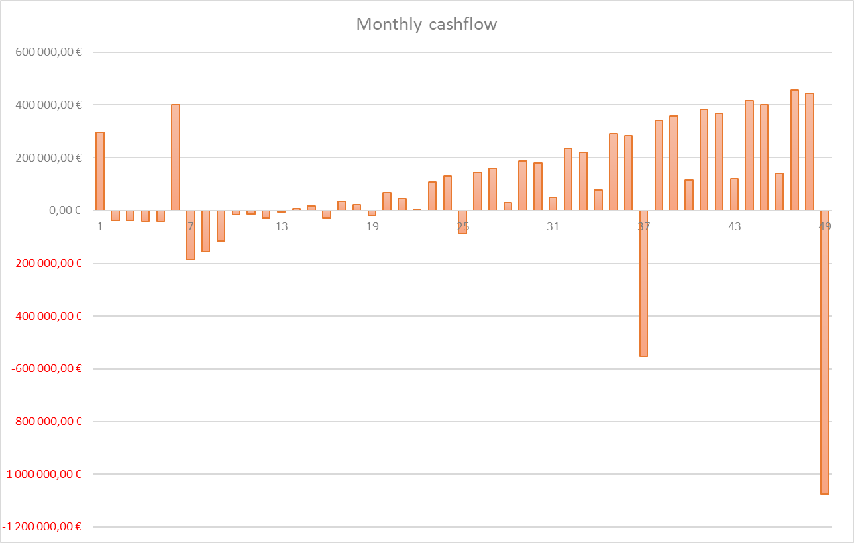
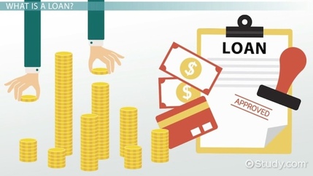

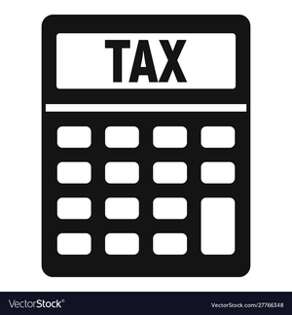
FORECAST OF CASHFLOW(4 YEARS)

Slide 11
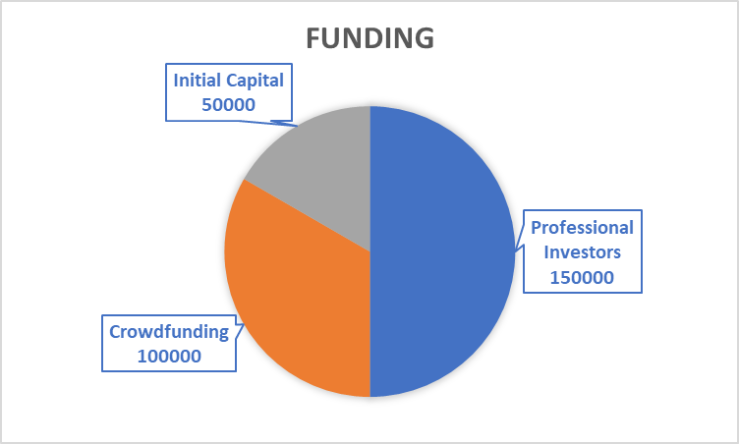
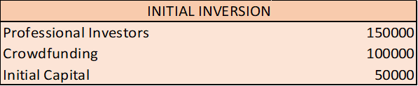
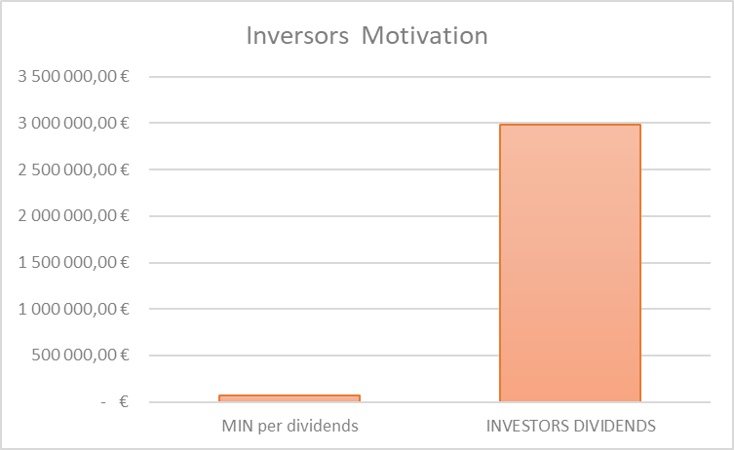
FUNDING
Inversors profitability of 995%

Slide 12
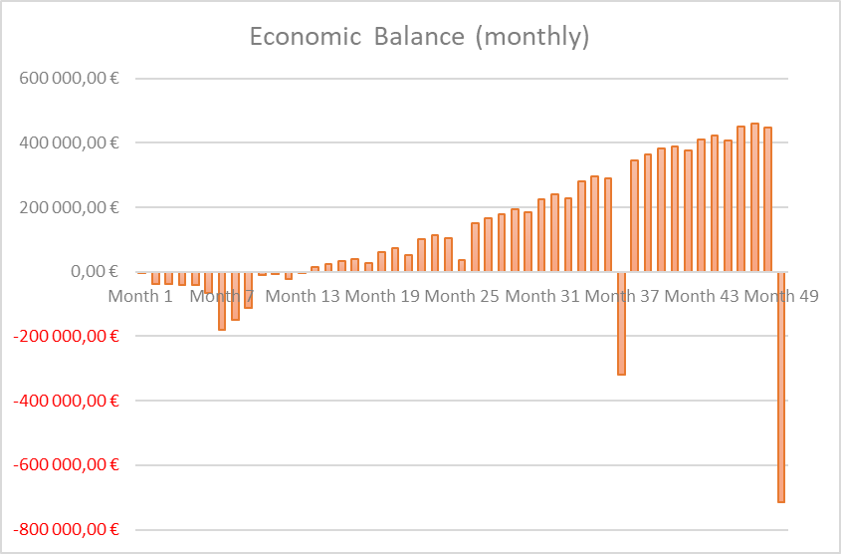
ECONOMIC BALANCE

Slide 13

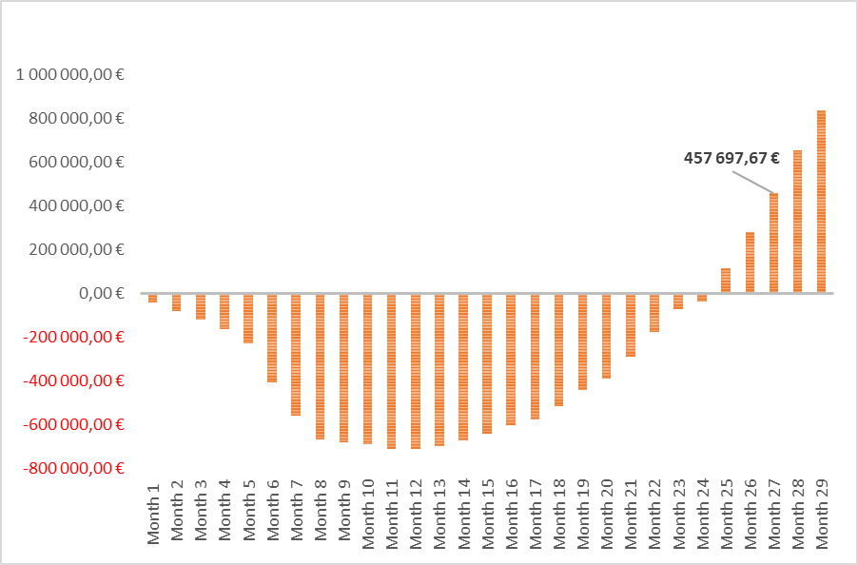
PAYBACK
27th
month
Our payback time in a realistic scenario is 27 months, which reflects the amount of time it takes to recover the initial investment cost of the 300.000€ funding we received.
The breakeven is reached at month 25.

Slide 14
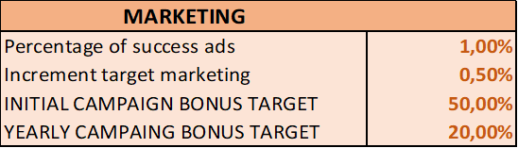
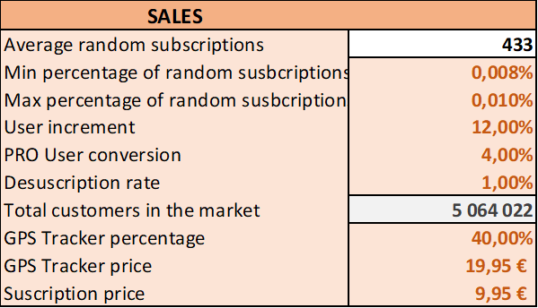
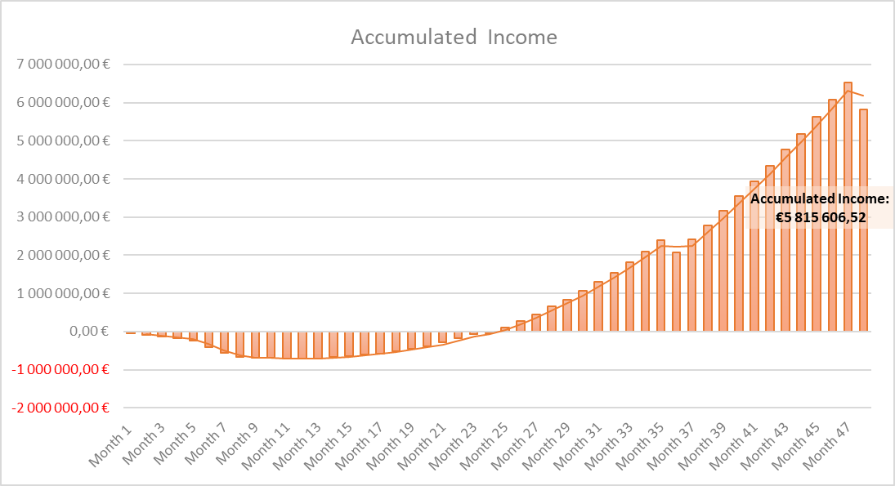
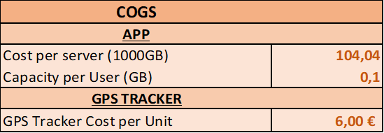
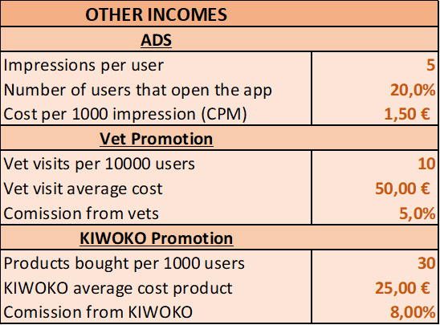
SCENARIOS - REALISTIC
Cost per engagement: 0.03€

Slide 15
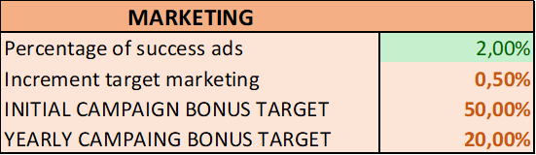
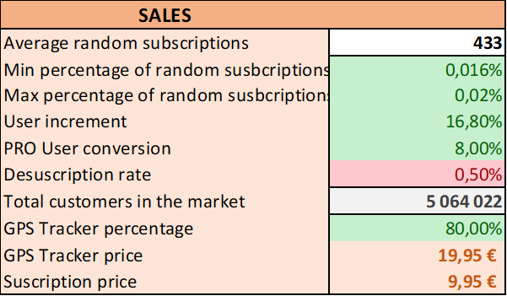
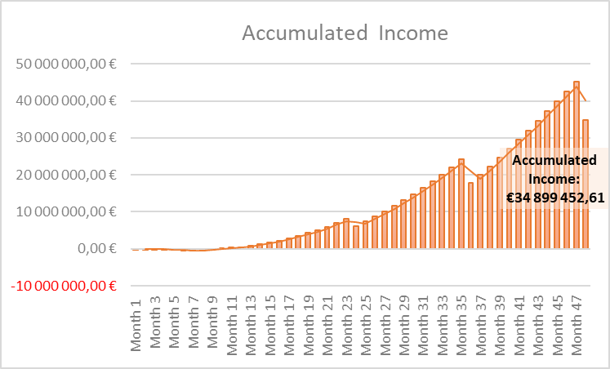
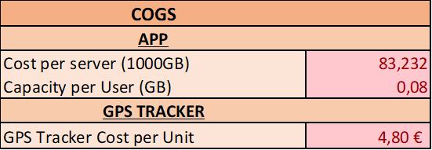
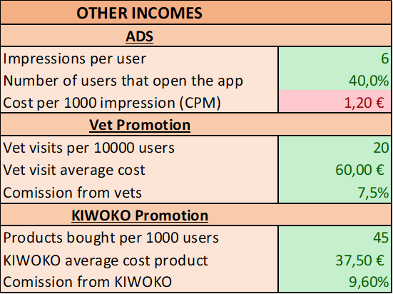
SCENARIOS - BEST CASE
Cost per engagement: 0.027€

Slide 16
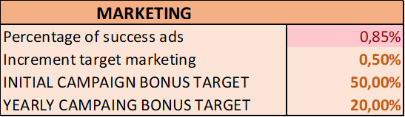
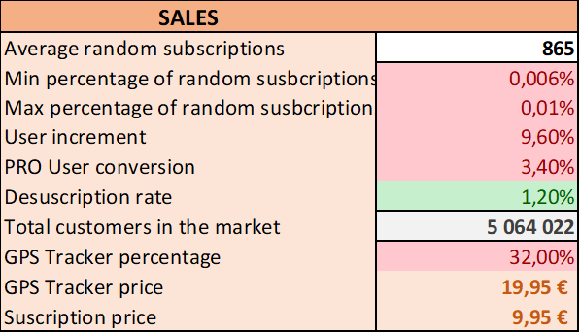
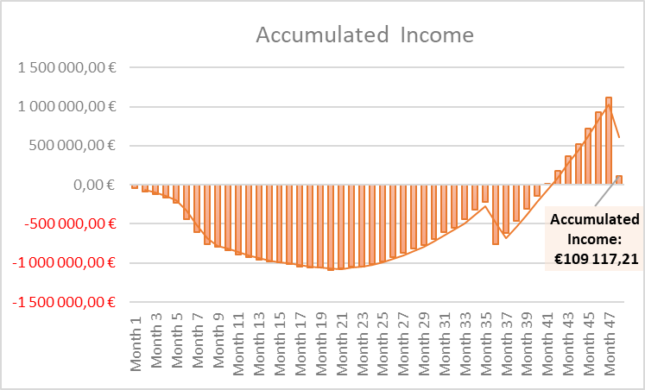
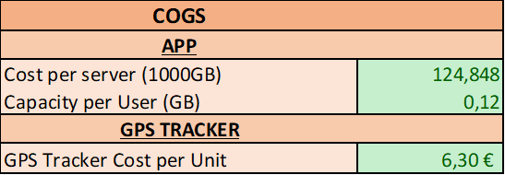
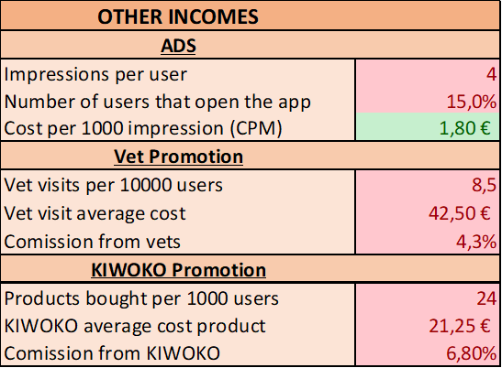
SCENARIOS - WORST CASE
Cost per engagement: 0.036€

Slide 17
EXTRA SCENARIOS

Slide 18
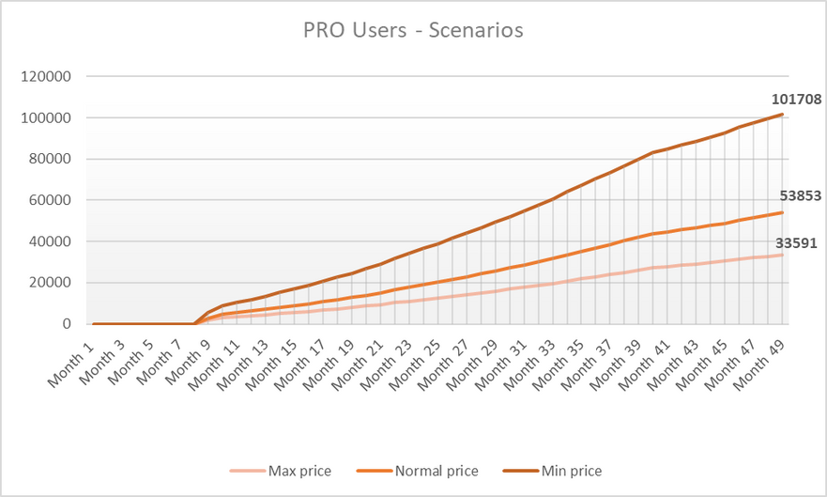
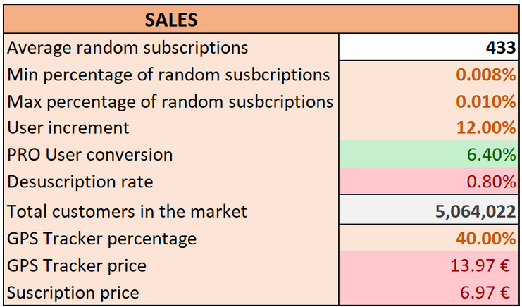
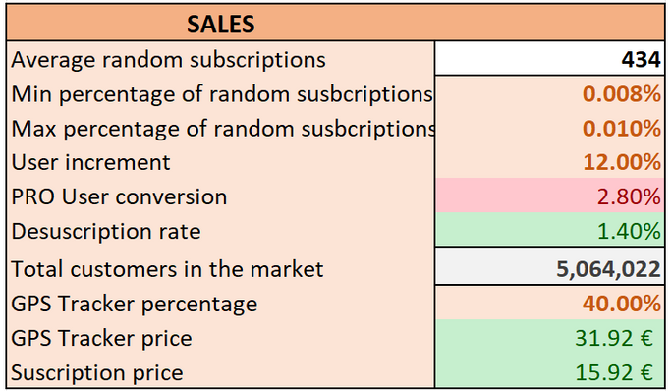
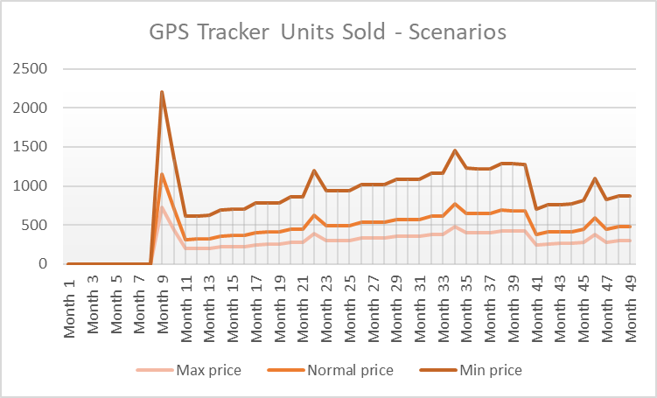
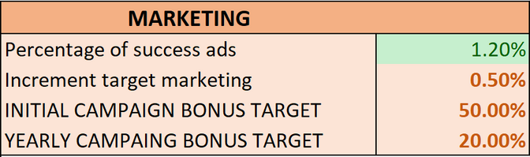
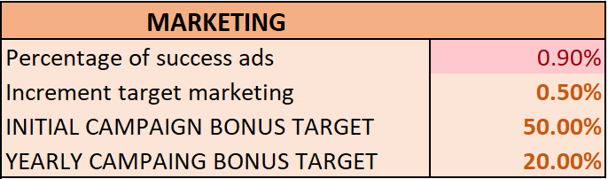
SCENARIOS: Price Variation I
Decreasing the price:
Increasing the price:

Slide 19
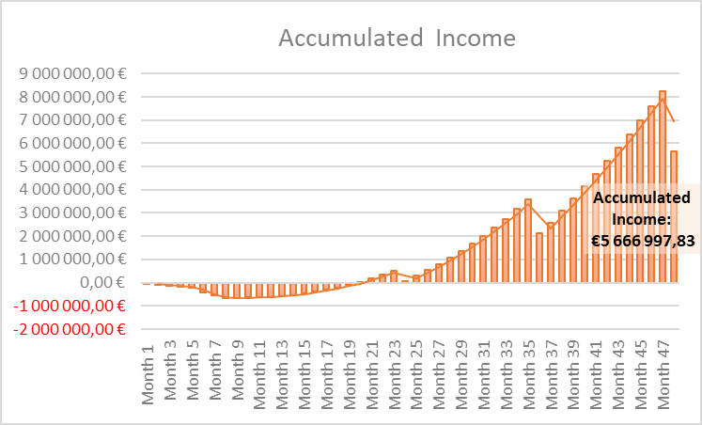
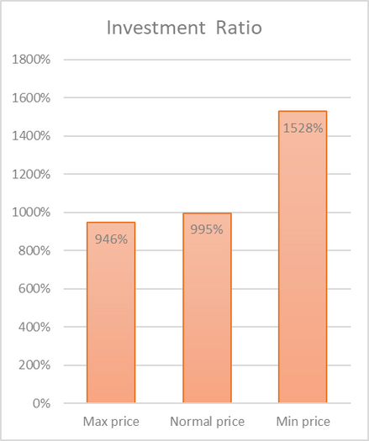
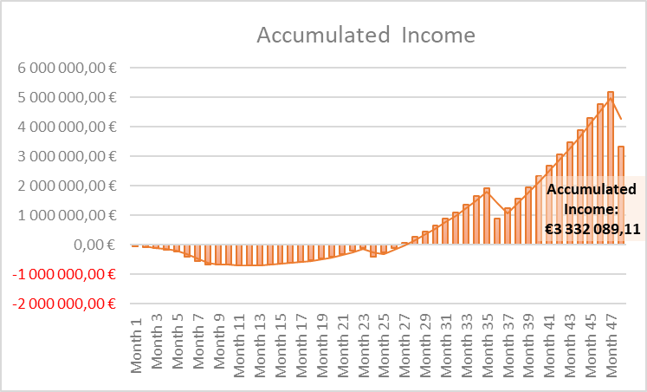
SCENARIOS: Price Variation II
Decreasing the price:
Incresing the price:

Slide 20
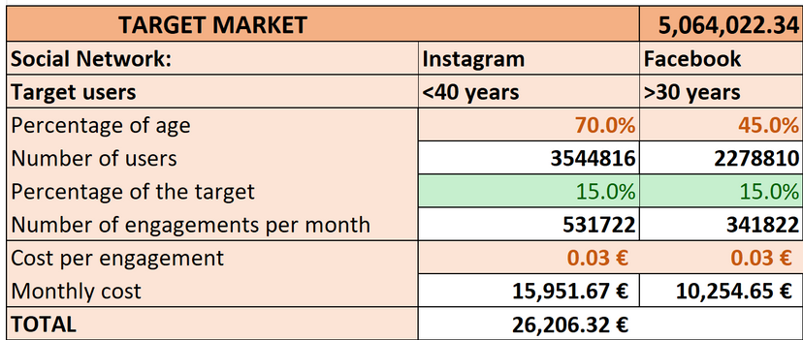
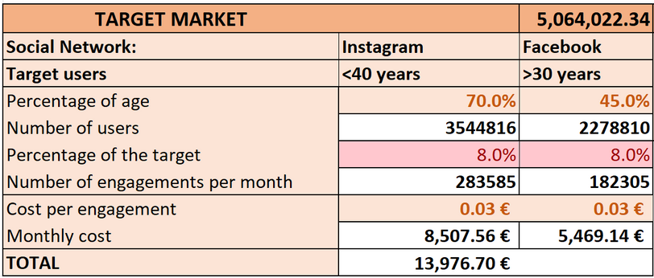
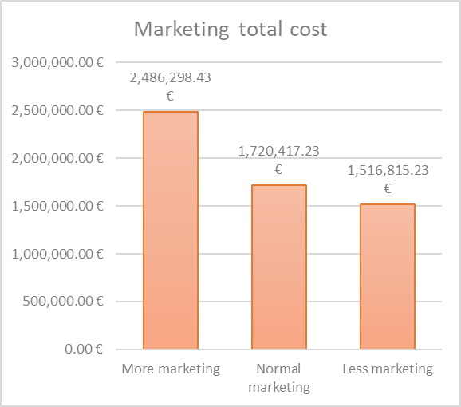
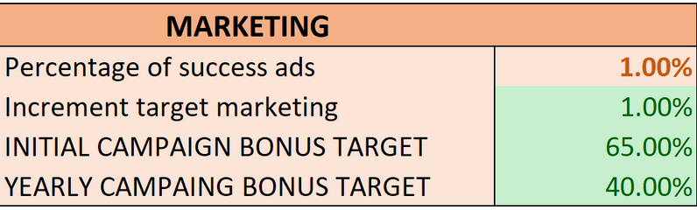
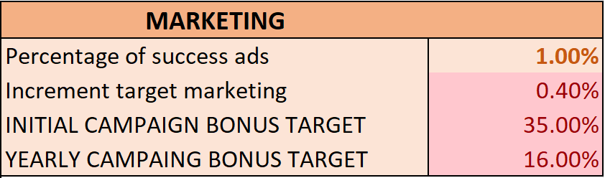
SCENARIOS: Marketing expenses I
Increasing expenses:
Decreasing expenses:

Slide 21



SCENARIOS: Marketing expenses II
Increasing expenses:
Decreasing expenses:

Slide 22






SCENARIOS: Improved case I

Slide 23


SCENARIOS: Improved case II

Slide 24


Thanks for your participation!
EMAIL | WEBSITE | SOCIALS
info@pocketpaw.com | www.pocketpaw.com | @pocketpaw

Slide 25

BACKUP SLIDES
Want to know more about our criteria, formulas or parameters used for modelling our previsions?
Is there lack of explanation in any of our accurate previsions?
Something isn't clear enough, or it just doesn't add up?
All of our expectations are fully documented and studied, as well as following meaningfull patterns from our study of the market behaviour, you just need to check out our full explanations in our backup slides or in the spreadsheets.

Slide 26
SCENARIOS: Some Notes
None of the previous parameters are randomly chosen, despite the abrupt difference between some of their results, everything has been carefully studied taking into account all the aspects of the market and all its components behaviour.
However, there are situations that we cannot perfectly predict, such as the possible behaviour of the users given a change of the product price. In that case, we have also accordingly changed the potential user increment variables, but since it can sometimes be unpredictable, we have made these parameters easily manipulable to enable anyone interested to see our expected previsions given any values of the user increment or other parameters. This allows to, for instance, seeing the results when increasing the price for different user increment values.
The same happens in the opposite case, decreasing the price could encourage competitors to do the same and change our previsions. Again, we have made the user increment variables according to this situation, but any possible context can be easily performed in our spreadsheets.

Slide 27
ECONOMIC FACTS
REVENUES
Sales
Ads on Free Version
Vet Promotion
KIWOKO promotion
EXPENSES
Salaries
Production
Servers
Marketing
Co-Working Office
Finance needs (Income) and Loan Payments (Expense) after analysis.

Slide 28



REVENUES - SALES: Users
Users prevision formula:
Parameters:
*Further explanation in back up slides
Actual data:

Slide 29

REVENUES - SALES: Users
Our sales mainly consist on the subscriptions and the Tracker units sold, so the PRO version subscriptors are the key.
Based on our promotion campagin and a study of the target market users behaviour, we expect the 4% of our users to subscribe to the PRO version.
Company Setup & Product Development

Slide 30
SALES: Users
Why this formula?
We consider a random amount of random new users who could end up in our app through not contemplated ways, such finding us through determined searches, randomly finding us in recommended apps, or even by mistake... These are modelled with ∆_B, which is based on a randomly originated number in our spreadsheets, based on two arbitrary bounds and modelled by the remaining target market.

Slide 31
SALES: Users
Why this formula?
After modelling the marketing campaign based on the not reached part of the target market and the annviersaries updates, we expect an increment of users directly dependent on that campaign investment, the ∆_M, concretely the 1% of the target users of each month.
The r_R is another parameter describing the expected rate of users increase from recommendation by existing users, so it has to be dependent on the existing numebr of users (U_i-1) but subsracting from it the expected unsubscribed users, which is another parameter that we expect to be the 1%, after analysing the behaviour of the actual app users in the market.

Slide 32
SALES: Users
Why this formula?
That factor that contemplates the probable increase of users independently of our market campaign, (Ui-1*(r_R-r_U)+∆B) is multiplied by a logarithm explicitly studied to smooth that function, whose main goal is to model that growth basing it in the total market too.
T is the total number of users in our target market, so when we have no users increase, that log is gonna return 1 and the formula is gonna return the total number of expected increase users, but while the user increase approaches the number of total potential users, it goes down until reaching 0 when we have reached the total target market( which is very improbable.
In this way, the number of users that we could expect to reach each month, it's now smoothly modelled by our share of the market, making more difficult to reach more customers when we have a bigger share.

Slide 33
REVENUES - SALES: Users
Why these parameters?
After studying some data in the previous presentation about the users interaction with new apps, we have learnt that close to a 10% of the remaining target market (multiplied by 10000) gets a reasonable amount of new users from not-intentioned or expected sources.
The user increment is the already explained recommendation rate, which we think it's reasonable to be smaller than 15%, but higher than 8%, given the high level of impressions spread throught the users community.

Slide 34
REVENUES - SALES: Users
Why these parameters?
As we already said, we expect the 4% of the total users to become PRO users, given the common engagement of internet and APP users in the actual market, and the 40% of these to also buy the GPS.
One could think that the totality of PRO users are gonna buy the GPS Tracker, since it's the main feature from the PRO version, but we, being conservative, have contemplated only the 40% of them, given that the fact of having another expense may prevent the half of them from buying it.

Slide 35
REVENUES - OTHERS
Why these other incomes?
Though our main sales previsions allow us to be optimistic, we expect to need more incomes to keep our company properly running, and we have made a realistic plan based on the actual information.
First, we consider offering an advertising service to other companies, with an average of a 20% of our users opening the app a day, receiving 5 impressions each one of them and charging 1.50€ per 1000 impressions, which is the standard cost in the social media.
We also have the partnership with KIWOKO and the Veterniaries, both of them are billateral, which means not only them promoting our product but we promoting their's and receiving a comission about that.
All the data has been studied from the actual market, for instance the average veterinary cost or the proportion of pet owners going to vet.

Slide 36




EXPENSES - SALARIES (20%)
temporal contracts

Slide 37
MARKETING
Why this formula?
We want to model how much people do we get from different criteria:
The already share of the market of our company.
The portion of the potential users that we want to reach (initially 10%, increases with the time to reach the rest of the market)
Special campaigns (The initial one and one per each anniversary, when we plan to launch a big update of our app and services).

Slide 38

MARKETING in Data
We expect these parameters to be the basis of our marketing modelling, most of them based on current trendencies (real cost of engagement and probable percentage of success ads.

Slide 39

EXPENSES - PRODUCTION (-1%)
Initial Provisions
Cost of a single unit: 6€ (cheaper provider found)

Slide 40



EXPENSES - COWORKING (2%)
BETAHAUS, FROM MONTH 2 >
4.800€/month
2x
*We avoid other expenses such as light, water, maintenance...

Slide 41



EXPENSES - SERVERS (2%)
*Includes web domain expenses

Slide 42



EXPENSES - DISTRIBUTORS
15% of subscriptions and products sales through both App Store and Play Store.

Slide 43


Amortization of computers

Slide 44

BP SCHEME - Monthly Income

Slide 45

BP SCHEME- Monthly Expenses

Slide 46

FORECAST OF CASHFLOW(4 YEARS)

